Slide 1
4. Dynamics
Content
4.1 Linear momentum
4.2 Newton's laws of motion – first , second , third.
4.2 Conservation of momentum – types of collision.

Slide 2
What is dynamics?
The relationship between force and motion is called dynamics and it deals with the explanation of motion
  Why do things move the way they do?
  What causes an object at rest to start moving?
  What causes a moving object to stop?
  Why does something continue to move?

Slide 3

Linear Momentum
The linear momentum of a body is defined as the product of its mass and velocity.
It is a vector quantity.
Momentum = mass x velocity, p = m v (unit: kg m/s)
Momentum tells us the effect or impact needed to get an object moving or stopping, unlike velocity which tells us how fast and in which direction the object is moving.
For example, an object of mass 100 kg and moving at a speed of 10 m/s due East would possess a momentum of 1000 kg m/s (Ns) in the same direction.

Slide 4
Linear Momentum
The amount of momentum which an object has is dependent upon two variables:
  1.) how much mass is moving and
  2.) how fast the mass is moving.
A fast moving car will have higher momentum than a slow moving car with the same mass.
A greater mass truck will have higher momentum than a smaller mass car travelling with the same speed.
Momentum is a vector quantity and the direction of the momentum is the same as the direction of the velocity.
On the other hand, force which is also a vector quantity and the direction of force is the same as the direction of acceleration.
However, direction of acceleration may not be the same as direction of velocity. (Eg: when car is slowing down)

Slide 5
Newton’s 3 Laws of motion
The First Law states that a body will remain in its state of rest or of uniform motion in a straight line unless a net external force acts on it to change that state.
The Second Law states that the rate of change of momentum of a body is directly proportional to the net force acting on it and takes place in the direction of the force. F_{net} = (mv-mu) / t.
Therefore, force can be defined as the rate of change of momentum.
The Third Law states that when two bodies interact, they exert equal and opposite forces on each other.

Slide 6
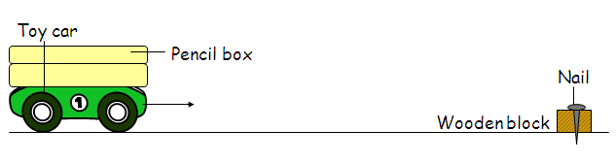
Newton's First Law
Newton’s 1st law states that a body will remain in its state of rest or of uniform motion in a straight line unless a net external force acts on it to change that state.
also known as The Law of Inertia.
Inertia is the property of an object to resist a change in state of motion.
In the absence of a net force, a body at rest will remain at rest and a body in motion will continue its motion in a straight line.
Inertia is quantified by mass, i.e the larger the mass, the greater the inertia.
Mass is a measure of inertia.
Example:

Slide 7
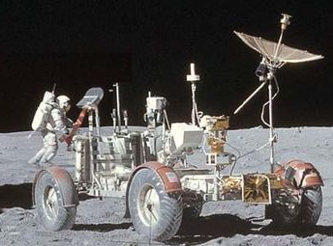
Difference between Mass & Weight
MASS | WEIGHT
a measure of body’s resistance to changes in motion | Gravitational force acting on a body / effect of gravitational force on a body
Value is constant regardless where it is | Its value varies with gravitational field it is located
Scalar quantity | Vector quantity
Measured in kilogram (kg) | Measure in Newton (N)
Example:
The mass of the moon-buggy is the same on the Moon &Earth, but its weight is smaller.
It will be no easier to push it along on the Moon than on the Earth.
This is because mass does not change. (F = ma)
But it will be easier to lift on the Moon than on the Earth.
This is because the weight is lesser. (W = mg)

Slide 8
Newton's Second Law
Newton’s 2nd law states the rate of change of momentum of a body is directly proportional to the net force acting on it and takes place in the direction of the force.
F α Δp/Δt ,
F α Δ(mv)/Δt ,
F α m Δv/Δt ,
F α ma ; F = kma , k =1. (By the definition of 1 Newton)
Thus, F = ma
1 Newton is defined as the force which when acting on a 1kg mass, produces an acceleration of 1 ms^{-2.}
Take note that:
a.) F = ma is not the 2nd law since it is valid only for a body of constant mass.
b.) In general, F_{net} = Δp/Δt = Δ(mv)/Δt.
This equation s more general since it includes the situation in which the
mass may change.
c.) Acceleration and resultant force are always in the same direction.
(F = ma)

Slide 9
Example 1
A body pulls a wagon of weight 300 N with a horizontal force of 20.0 N.
What acceleration does the wagon receive? Assume there is no
frictional force opposing the motion of the wagon. (a = 9.81 ms^{-2.})
F_{net} = ma
20 = (300 / 9.81) a
a = 0.654 ms^{-2.}

Slide 10
Example 2
100 kg
F
A box with mass 100kg is pulled by a force of F N on a smooth floor.
a) If F = 200N, calculate the acceleration of the box
F = ma
200 = 100a
a = 2.00ms⁻²
b) If the velocity of the object changes from 0ms⁻¹ to 15.0ms⁻¹ in 10s when a
force is acting on it, what is the magnitude of the force?
a = v – u = 15.0 – 0
t 10
= 1.5 ms⁻²
F = ma
= 100(1.5)
= 150N
Notes:
10

Slide 11
Example 3
A rocket develops an initial thrust of 3.3 x 10⁷ N and has a lift off mass of
2.8x10⁶ kg. Find the initial acceleration of the rocket at lift off.
(a = 9.81 ms^{-2.})
F_{net} = ma
T - W = ma ; W = mg
(3.3 x 10⁷ ) – (2.8x10⁶)(9.81) = (2.8x10⁶) a
a = 2.0 ms^{-2.}

Slide 12
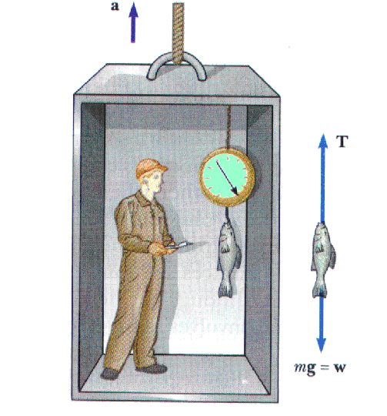
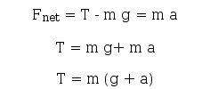
Elevator accelerating upwards
Apparent weight more than true weight

Slide 13
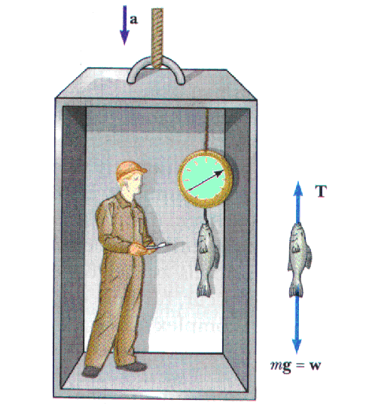
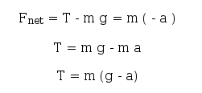
Elevator accelerating downwards
Apparent weight less than true weight

Slide 14
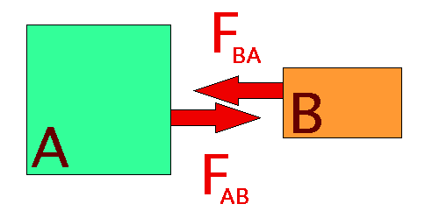
Newton's Third Law
Newton’s 3rd law states that when two bodies interact, they exert equal and opposite forces on each other.
Also known as the Law of Action and Reaction.
The force that object A exerts on object B is the same as the force exerted by object B on object A but opposite in direction i.e. to every action there is a force equal in size and opposite in direction.
An object cannot experience a force by itself i.e. forces always occur in pairs. One cannot exist without the other.

Slide 15
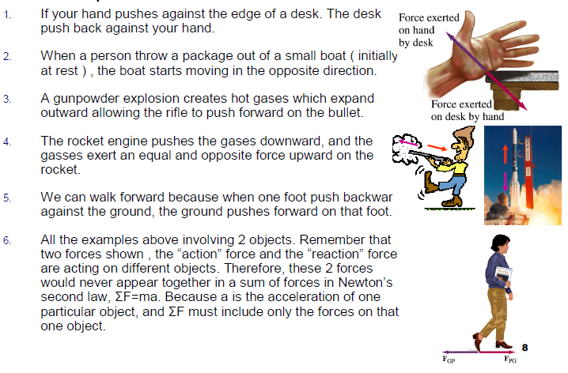
Example of Newton’s Third Law

Slide 16
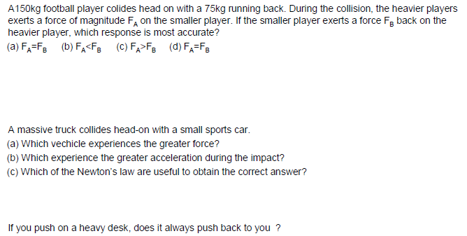
Example 4

Slide 17
Example 5
1.) A box with mass 5kg is moving at a constant velocity when a force of 10N acts on it. Calculate:
a) the friction acts on the box
The horizontal forces that act on the box are the force of 10N and the friction. Both of the forces are equal if the box is moving at a constant velocity, so
Friction = F (at the opposite direction)
= 10.0N
b) acceleration of the box if the force acts on it is 20N
When F₁ = 20N,
F = F₁ – friction
= 20 – 10
= 10N
F = ma
10 = 5a
a = 2.00ms⁻²
Friction
F = 10N
a
Friction = 10N
F = 20N
Notes:
17

Slide 18
Example 6
An object of mass 2.00 kg is attached to the hook of a spring-balance, and the balance is suspended vertically from the roof of a lift. (take g as 9.81 ms⁻²).
What is the reading of the spring-balance when the lift is
a) going up with an acceleration of 0.2 ms⁻²
T - mg = ma
T = ma + mg
T = (2 x 0.2) + (2 x 9.81) = 20.0 N
b) going down with an acceleration of 0.1 ms⁻²
T – mg = ma
T = ma + mg
T = (2 x -0.1) + (2 x 9.81) = 19.4 N
c) ascending with a uniform velocity of 0.15 ms⁻¹
T = ma + mg
T = 0 + mg = 19.6 N

Slide 19
Example 7
A truck A of mass 1000 kg pulls a trailer B of mass 3000 kg. The truck engine exerts a force of 8000 N which results in frictional forces of 2000 N and 1000 N respectively on B and A.
Calculate:
a) the acceleration of the truck and trailer ,
For B only,
T - 2000 = 3000a ……….. (1) where a = acceleration
For A only,
8000 - 1000 - T = 1000a ……….(2)
Solving the simultaneous equation:
8000 - 1000 - 2000 = 4000a giving a = 1.25 m s⁻²
b) the tension T in the tow-bar.
From equation (1),
T = (3000 x 5/4) + 2000 = 5750 N

Slide 20
Conservation of Linear Momentum
The principle of the conservation of linear momentum states that, for any collision in an isolated system, the sum of the momentum before any event is equal the sum of the momentum after the event provided no external resultant force acts on it.
While the momentum of a system is always conserved in interactions between bodies, some change in kinetic energy always takes place in practice.
We usually apply this principle of conservation of momentum when we consider events like collision & explosion.

Slide 21
Collisions
In a collision, the total momentum of an isolated system of objects remains constant.
momentum before = momentum after
m₁u₁ + m₂u₂ = m₁v₁ + m₂v₂
As long as there are no external forces applied, conservation of momentum is valid.
Types of collisions: elastic, inelastic, & perfectly inelastic collisions.

Slide 22
The 3 types of collisions
1.) Elastic Collision:
- Momentum is always conserved (m₁u₁ + m₂u₂ = m₁v₁ + m₂v₂)
- Kinetic energy is always conserved (½m₁u₁² + ½m₂u₂² = ½m₁v₁² + ½m₂v₂² )
- Total energy is conserved
- After collision, the objects must SEPARATE
- Relative velocity of approach = Relative velocity of separation
(u₁ - u₂ = v₂ – v₁)

Slide 23
The 3 types of collisions
2.) Inelastic Collision:
- Momentum is always conserved (m₁u₁ + m₂u₂ = m₁v₁ + m₂v₂)
- Kinetic energy is NOT conserved
- Total energy is conserved
- After collision, the objects must SEPARATE

Slide 24
The 3 types of collisions
3.) Perfectly Inelastic Collision:
- Momentum is always conserved [ m₁u₁ + m₂u₂ = (m₁ + m₂) v ]
- Kinetic energy is NOT conserved
- Total energy is conserved
- After collision, the objects STICK TOGETHER

Slide 25
The 3 types of collisions
COLLISION TYPE | (PERFECTLY) ELASTIC |  | INELASTIC | PERFECTLY INELASTIC
MOMENTUM | CONSERVED
 | (m₁u₁ + m₂u₂ = m₁v₁ + m₂v₂) |  |  | m₁u₁ + m₂u₂ = (m₁ + m₂) v
KINETIC ENERGY | CONSERVED (½m₁u₁² + ½m₂u₂² = ½m₁v₁² + ½m₂v₂² ) |  | NOT CONSERVED (½m₁u₁² + ½m₂u₂² ≠ ½m₁v₁² + ½m₂v₂² )
TOTAL ENERGY | CONSERVED
RESULTS AFTER COLLISION | OBJECTS SEPARATE |  |  | OBJECTS STICK TOGETHER
RELATIVE SPEED OF APPROACH & SEPARATION | (u₁ - u₂ = v₂ – v₁) | (u₁ - u₂ ≠ v₂ – v₁)

Slide 26
Example 8
A lorry with a mass of 8000 kg is moving at 30 m s⁻¹. The lorry then collides
with a car of mass 1500 kg from the back which moves at 20 m s⁻¹. After
collision, the lorry moves at 20 m s⁻¹. Calculate the velocity of the car after the
collision.
Solution
m₁v₁ + m₂v₂ = m₁u₁ +m₂u₂
8000(20) + 1500 v = 8000(30) + 1500(20)
160000 + 1500 v = 270000
1500 v = 110000
v = 73.3 m s⁻¹
Notes:
26

Slide 27
Example 9
A trolley with a mass of 2.5 kg is moving on a smooth surface at 2.8 m s⁻¹
collides with another stationary trolley of mass 1.0 kg. After the collision, the
first trolley moves at 1.9 m s⁻¹. Calculate:
a) the total initial momentum
p = m₁u₁ + m₂u₂
= 2.5(2.8) + 1(0)
= 7 kg m s⁻¹
b) the total final momentum
The total final momentum is same as the total initial momentum because:
m₁v₁ + m₂v₂ = m₁u₁ + m₂u₂
therefore the total final momentum is 7 kg m s⁻¹
c) the velocity of another trolley
m₁v₁ + m₂v₂ = m₁u₁ + m₂u₂
2.5(1.9) + 1 v = 2.5(2.8) + 1(0)
4.75 + 1 v = 7
1 v = 2.25
v = 2.25 m s⁻¹
Notes:
27

Slide 28
Relative speeds
(applicable for Elastic Collision only)
Another way of proving / solving elastic collision is using relative speed.
In a elastic collision, the relative speed of approach is the same as the relative speed of separation
The above equation can be obtain from the equation of conservation of momentum and conservation of kinetic energy.
Conservation of Momentum: -
m₁u₁ + m₂u₂ = m₁v₁ + m₂v₂
rearranged as, m₁(u₁ – v₁) = m₂(v₂ – u₂) ...............(1)
Conservation of Kinetic Energy: -
½m₁u₁² + ½m₂u₂² = ½m₁v₁² + ½m₂v₂²
rearranged as, ½m₁(u₁² - v₁²) = ½m₂(v₂² – u₂²) .…..(2)
Divide Eq. (2) / (1) :-
u₁ – u₂ = v₂ – v₁
u₁ + v₁ = v₂ + u₂
(u₁ - u₂) = (v₂ – v₁)
Notes:
28

Slide 29
Example 10
A ball of mass 0.500 kg travels with a speed 2.0 m s⁻¹ to the right and collides with another ball of equal mass 0.500 kg traveling with a speed of 1.0 m s⁻¹ in the opposite direction.
If the collision is perfectly elastic, show that the velocity of first ball is 1.0
m s⁻¹ to the left and the second ball is 2.0 m s⁻¹ to the right.
Notes:
29

Slide 30
Example 11
A body A, of mass 6 kg, moving at 9 m s⁻¹ collides with another body, B of mass 3 kg moving in the same direction as A at 4 m s⁻¹. If the velocities of A and B after the collision are respectively v_{A} and v_{B}, calculate v_{A} and v_{B}. (Assume that the collision is perfectly elastic and no external forces act on the system). [v_{A}=5.67 m s⁻¹; v_{B}=10.67 m s⁻¹]

Slide 31
Example 12
2 trolleys moving in opposite directions, A of mass 1 kg and velocity 2 m/s and B of mass 4 kg and velocity 3 m/s, collide and stick together. Take A as positive to the right.
a.) Assuming there is no friction, what is their velocity after the collision?
Since total momentum is the same before and after,
5v = -10, v = - 2 m/s
b.) From the previous example of the trolleys, when the trolleys collide, how much of their total
kinetic energy is lost(i.e. converted to other forms)?
K.E. = ½ mv²
Total K.E. before collision = 20 J, Total K.E. after collision = (½ x 5 x (-2)²) = 10 J
Thus, 10 J has been lost.
c.) if the collision had been elastic, what would the velocities of the trolleys have been after the
separation?
-10 = (1 x v₁) + (4 x v₂) : conservation of momentum equation
5 = (v₂ - v₁) : relative speeds equation
v₁ = - 6 m/s and v₂ = - 1 m/s

Slide 32
Explosion
Is an inelastic collision because the kinetic energy is not conserved
Example 13:
A bullet with a mass of 30 g is fired from a shotgun of mass 2.50kg. If the bullet
leaves the muzzle with a velocity of 50 m s⁻¹, find:
a.) the total momentum before firing
p = m₁u₁ + m₂u₂
= 0.03(0) + 2.5(0)
= 0
b.) the total momentum after firing
The total momentum after firing is same as the total momentum before firing because:
m₁v₁ + m₂v₂ = m₁u₁ + m₂u₂
therefore the total momentum after firing is 0.
c.) the recoil velocity of the shotgun
m₁v₁ + m₂v₂ = m₁u₁ + m₂u₂
0.03(50) + 2.5 v = 0.03(0) + 2.5(0)
1.5 + 2.5 v = 0
2.5 v = -1.5
v = -0.6 m s⁻¹
Notes:
32

